Slide 1
AnK [Accelerated Komputing]
Hari Prasad Gajurel

Slide 2
Table of content
Background
Problem statement
Black Box model
Summery
Further Work

Slide 3
Problem statement
Develop the transient based Tran solver model

Slide 4
Background : Previous work
Visualization of the inference
Visualization of the training and validation
File Conversion to .vtk

Slide 5
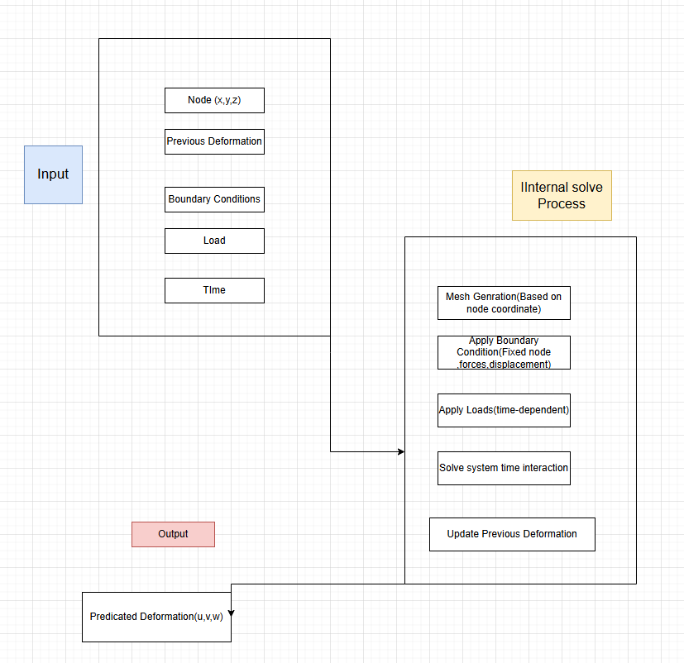
Black Box model

Slide 6
Summery
Literature review
Black Box model
Try to feed data into model
Learn about 2D deformation through trnasolver

Slide 7
Further work
Make model
Feed proper data
Train the model correctly

Slide 8
THANK YOU

